Slide 1

Presentation of Minor Project
Multitasking web

Slide 2
Group Members
1. Bedprakash (201500189)
SUBMITTED TO :
Faculty name :
Mr. Bhanu kapoor
(Technical Trainer)

Slide 3
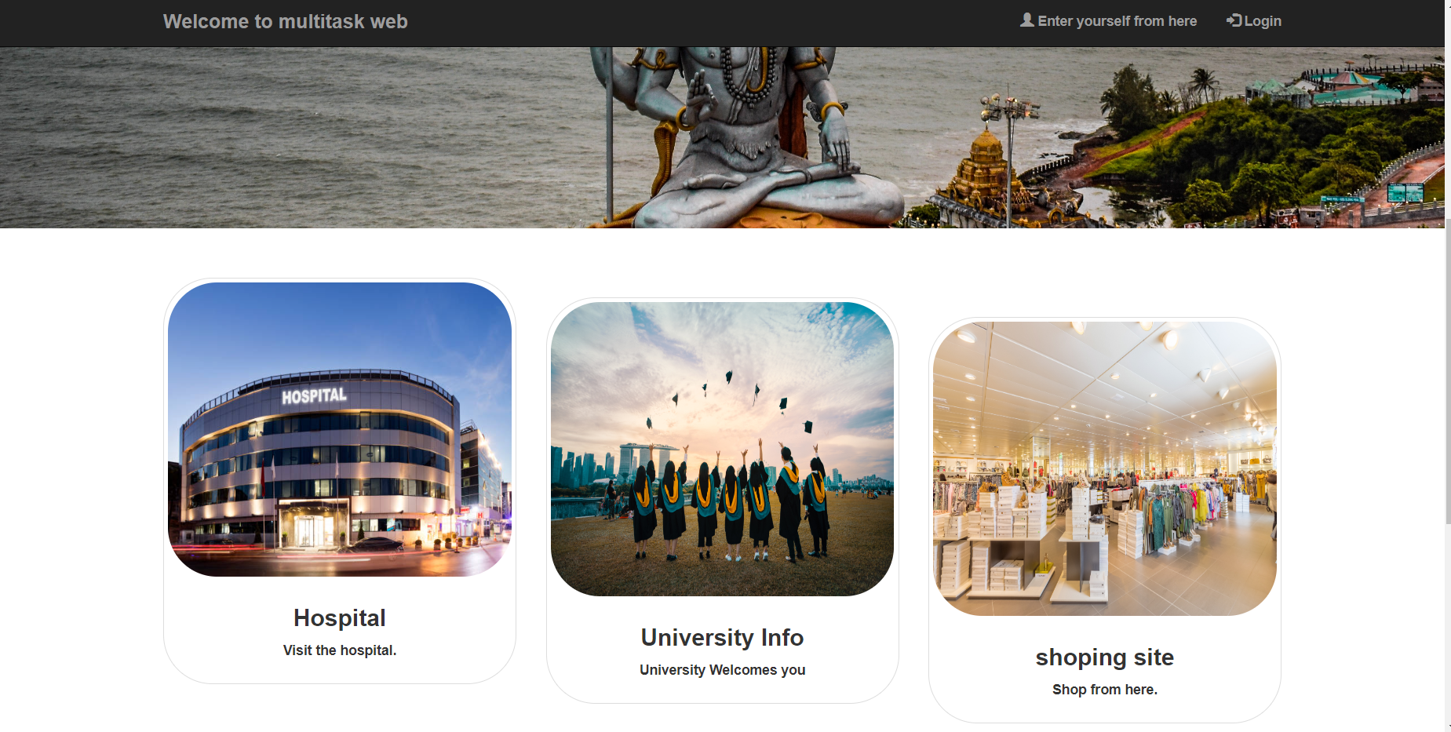
Our Taxonomy
“Multitasking web” is named after multiple technologies, that we want to create a house for products and other good technologies.so working upon these requirements we had this taxonomy “Multitasking Web”.

Slide 4
What are we working upon :
1. Online support to guide the best product and information according to need.
2. learning to make this type of helpful website through our expert.
3. selling of good products.
4.good hospitality and better suggestions and information regarding the products
5. music system and health related subjects

Slide 5
About the Project
The project named “MultiTasking Web” is online service where we can do multiple task on a single website where you can shop anything you can get the information about college , you can consult yourself from well educated and experienced doctors . Injoy yourself with music and sports , people will first have to create an account objectives on various topics regarding technologies .this full fledged front end website.
People can also contact our expert to learn these technologies.
Quad
Drone…

Slide 6
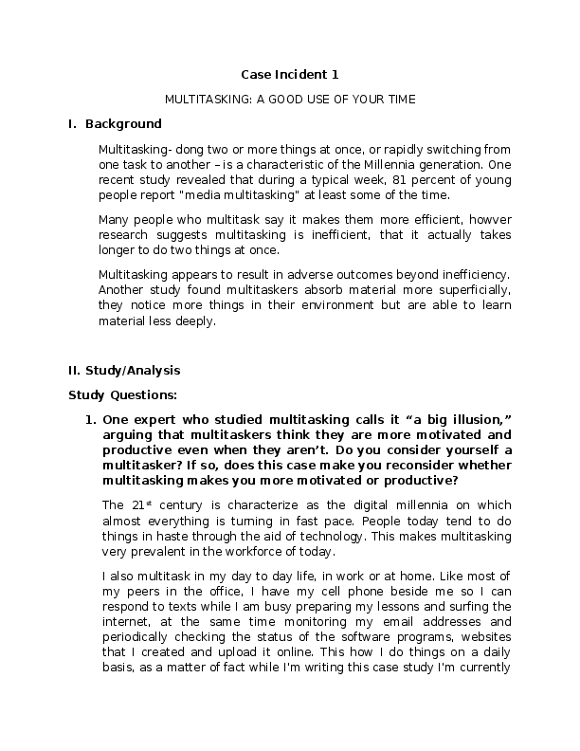
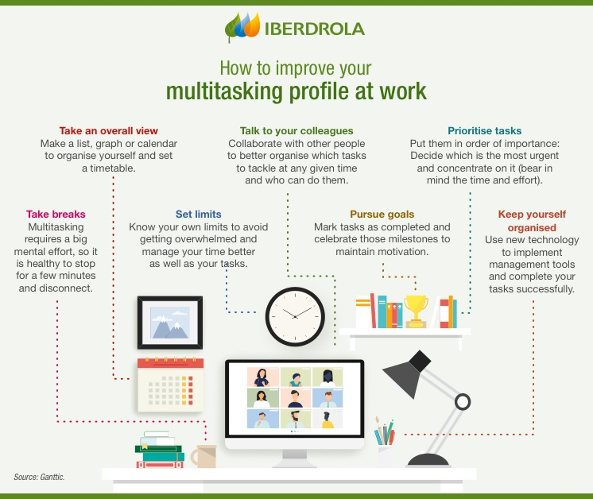
MultiTasking Profile at work…

Slide 7
Primary reason to choose this Project
I chose “Multitasking Web “ as My project because I wanted to save peoples time and efforts. Now days every person is busy in his/her daily life they don’t have time to purchase anything physically from the particular shops so i prefer to make this projects to make peoples daily life easy

Slide 8
Major Requirements
1. web design
2.content
3.text
4.images
5. coding
6. hosting through github
7.html,css,bootstrap
8. github
9.pixabay

Slide 9
Things we have done so far
So far , we have provided the front end to our website with one google form on it at contact bar , we have used HTML5 for tagging and css for image implementation.
In this we have used a scripting language “Javascript” to provide the functioning to this web application.
We have also showed the real images of website which are made by our experts(Pixabay).

Slide 10
Things we are going to do …
We are going to add backend to our website and we are going to provide a large data to it. Like a person can simply shop , learn and sell aeriel technologies within our site.
Working on major scale to improve my website

Slide 11
Scope of the Project
Our Scope is to develop an appealing Frontend with easy to understand of user Interface and a comfortable user experience with working user input like shopping , email login , page information for Multitasking web activities. Currently we are at initial stage of our project , we would highly like to extend the project on higher scale.

Slide 12
references
Quora
Aeromodelling club
pixabay
MDN
Bootstrap.com
Google docs

Slide 13
HARDWARE AND SOFTWARE SPECIFICATION
HARDWARE AND SOFTWARE SPECIFICATION
• Hardware requirements:
• Processor: Intel dual core or above
• Processor Speed: 2.4 GHZ or above
• RAM: 8 GB RAM or above
• Hard Disk: 30GB hard disk or above •
• Software requirements:
• Language: Microsoft Visual Studio 2008

Slide 14
Scope of the Project
Our Scope is to develop an appealing Frontend with easy to understand of user Interface and a comfortable user experience with working user input like shopping , email login , page information for drone activities. Currently we are at initial stage of our project , we would highly like to extend the project on higher scale.

Slide 15
Website (links)
Report Link: https://drive.google.com/file/d/1QPDyf-1P25A3C531zO4jrKppbpvrmb0X/view?usp=sharing
Synopsys link: https://drive.google.com/file/d/16CXBu1Fd8ljY02pI283sI_gWbOBCaEfy/view?usp=sharing

Slide 16
THANKYOU !
.

